Slide 1
Chapter 2 Part II
Authentication, Identity

Slide 2
Authentication
Before they can perform any activities in the system both users and systems must identify themselves and be authenticated.
Identification and Authentication (I&A) use some kind of protocol to establish identity.
I&A is the basis for authorization and for logging, it provides accountability.
Once verified, the system may provide a proof of authentication and a handle (reference) to the user’s account. For example, IBM’s z/OS provides an accessor environment element (ACEE), which follows the authenticated process during its execution
.

Slide 3
System
legitimate
authorization
user
resources
X
X
hacker
authentication

Slide 4
Approaches to authentication
Something the user knows. Passwords are the most common example of this type.
Something the user has. Typically a smart card.
Something the user is (biometrics). A body feature of the user, e.g. her fingerprints, is used to authenticate the user.
Where the user is. The location of the user is enough to grant him access

Slide 5
Formally
An authentication system can be defined formally as a 5-tuple (A,C,F,L, S), where A is the information needed to prove identity, C is the information used to validate the user request, F is a complementation function f: A → C; L is a set of functions used to validate identity, and S are functions to let the user create or modify information in A or C.
In a password system: A are the strings that correspond to the user-chosen passwords, C is the list of passwords in the system, F is the identity function {I}, L is the equality function {=}, and S is a function to set or change passwords.

Slide 6
Authentication hierarchy
Starting from an abstract authentication pattern we can define more specific (concrete) authentication methods
An Abstract Security Pattern (ASP) is a security pattern that describes a conceptual semantic restriction in a domain which can be a defense to a threat or a way to comply with a regulation, with no implementation aspects [Fer14].
An ASP describes the essential functions that must be present to handle a threat or regulation in an implementation-independent way. For example, “only the owners of accounts in a financial institution are permitted to withdraw money from them” is a typical semantic restriction. A concrete pattern describes a security solution within a technological context, e.g., distributed systems, XML web services, etc.

Slide 7
An authentication hierarchy

Slide 8
Class diagram of Authenticator

Slide 9
Sequence diagram for the use case “Authenticate a subject”

Slide 10
Threats for the Abstract Authenticator
T1. Present fake or stolen proof of identity, to let the attacker impersonate a legitimate subject.
T2. Steal the proof of authentication.
T3. Unauthorized reading of authentication (identity) information.
T4. Unauthorized modification of identity information.
T5. Register a subject using false information.
More systematic: consider the threats to each use case such as register a subject, modify subject authentication information, remove a subject, authenticate a subject. Compare to my list above.

Slide 11
Passwords
Passwords are considered a relatively weak approach. Most passwords are easy to find using a good dictionary, educated guesses, and a program that tries them in succession.
For better security the Unix password system uses slower encryption, produces less predictable passwords with a password generator, and uses ‘salting’. Salting implies that the password is encrypted using the concatenation of the time of the day and the process id as a key; the encrypted password is then concatenated with the time of the day and the process id.
The main problems with passwords are that users choose poor passwords and that they are kept for long periods of time, which means that the attacker has time to find a way to discover them.
A common attack is to get a copy of the encrypted passwords (some systems don’t protect the password file itself) and perform dictionary or exhaustive attacks.

Slide 12
Password-based authentication

Slide 13
Smart cards
A card with some processing power is used to establish the connection. Smart cards use a PIN provided by the user and other information such as date, time, or name of the user to send an encrypted message to the system (typically some Authentication Server). Only if the system can decipher the message the user is connected.
The card must be tamper-resistant to prevent a person who steals the card from finding the PIN in the card. Given that these cards have a significant amount of memory there have been proposals about including in them financial, health, and employment information about their owners, although this may bring additional privacy problems.
More secure but more costly than passwords, can be lost of stolen.
Frequently used by employees of a company to connect remotely to their systems.

Slide 14
Biometrics
This is the use of some unique personal characteristic, e.g., fingerprints, retina scan, face contour, face recognition, signature dynamics. This can be a more secure approach but it is more expensive and slower than the other two.
Fingerprint recognition security has been put in doubt, people leave their fingerprints in many places and gummy fingers appear to fool most systems.
They require a large amount of data. If their digital representation is compromised they cannot be replaced.
After the September 11 attacks this approach has become considerably more popular. This popularity has also been helped by the decreasing cost of some of these approaches.

Slide 15
Multifactor authentication
For higher security we can use Multi-factor Authentication, using two of the three authentication factors: something the user has, something the user knows, and something the user is.
For example, Google can send you text messages, with a code sent to your phone (something you have) every time you log in with a password (something you know) or as most banks use for their online banking a security question that (supposedly)only you can answer(something a user knows).

Slide 16
Class diagram for two-factor authentication

Slide 17
Sequence diagram for use case “Request authentication”

Slide 18
Known uses
Windows Office 365--Will send a security code to your phone or your alternate email address.
Google--a code will be sent to your phone via text, voice call, or our mobile app. Or, if you have a Security Key, you can insert it into your computer’s USB port.
Bank of America--You will be asked three random questions that only you know how to answer.
Apple--You can only sign in through an approved device and your Apple Id.
Department of Defense--Uses the YubiKey along with a one time password
Others include: Wordpress, Facebook, Twitter, and DropBox.

Slide 19
Identity management
Authentication relies on uniquely identifying users and other entities, and requires an identity management system that has information about all the legitimate users of the system
Users can have more than one identity, related to their roles
Each identity is defined by a set of attributes
There are identity standards: Liberty Alliance (IBM, Visa, HP…), Microsoft Account (MSA)

Slide 20
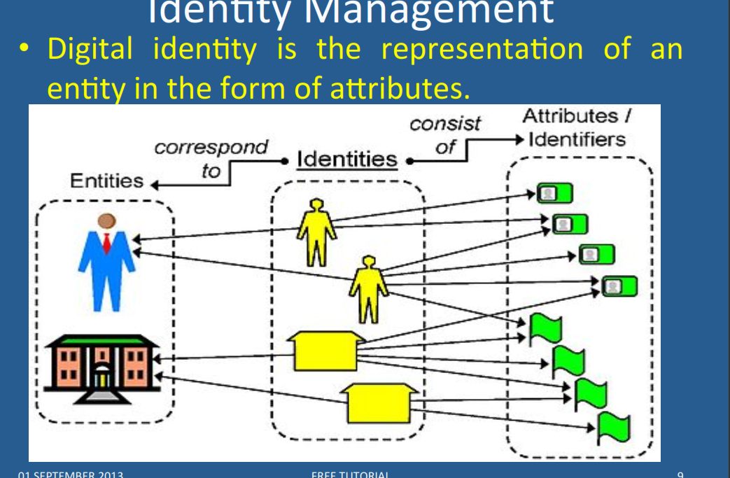

Slide 21
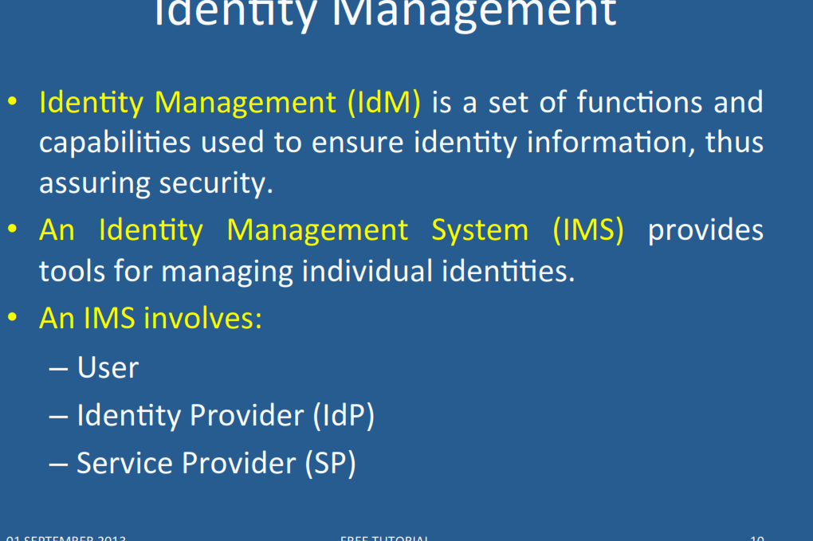

Slide 22
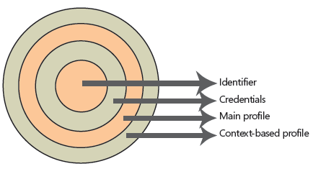
Digital identities

Slide 23
Identities
The innermost layer is the unique identifier of this digital identity. There should be no identical unique identifiers in the same security domain. Users must have unique identifiers to be easily recognizable by any system to which they have access.
To have access to this identifier, the user must present to the security system a set of credentials that will be checked against the computing secrets stored in the identity database. A user is entitled to access her own unique identifier if and only if she presents the correct set of credentials to unlock this magic number.
After the user unlocks the unique identifier, a set of common attributes (called the main profile) is accessible to a system that may require a little more knowledge than the unique identifier itself. This can be, for example, the user name, department, Social Security number, company name, and so on. These attributes do not vary from system to system; they are the same wherever the user logs on. They are a fixed set of values that are tied to the user during the lifetime of the logon session.

Slide 24
Identities II
But not all systems need to share information.
There are sets of information that are only meaningful in the context of a system or related systems. For example, frequent flier miles are meaningful only under the context of an airline carrier, losing most of its meaning if moved from one carrier to another. But they share the same semantic context when used by the mileage program associates (restaurants, hotels, credit cards, and so on). These sets of attributes are stored in the context-based profile.
One digital identity can have only one unique identifier, a limited set of credentials (username/password pair, digital certificate/pin number pair, biometrical data), a unique set of main profile attributes, and an unlimited set of context-based profile attributes.

Slide 25
Distributed identities
A user in a domain may use her identity in several autonomous systems if they trust each other and form an identity federation.
Each involved domain must have its own service provider
Identity providers issue credentials accepted by the members of the identity federation
The SSO in the next slide shows the idea: a user gets authenticated in her domain and then accesses another domain using SAML
We wrote a set of patterns for these three concepts

Slide 26
(Single Sign On) SSO pull model

Slide 27
Identity management patterns

Slide 28
Identity Federation

Slide 29
Circle of Trust
The Circle of Trust pattern allows the formation of trust relationships among service providers in order for their subjects to access an integrated and more secure environment.
Context: Service providers that provide services to consumers (subjects) over large systems such as the Internet.

Slide 30
Circle of trust class diagram

Slide 31
Identity Provider
The Identity Provider pattern allows the centralization of the administration of subjects’ identity information for a security domain.
Context: One or several resources, such as web services, CORBA services, applications, etc, that are accessed by a determined set of subjects. The subjects and resources are typically from the same organization.
Problem: Each application, or service may implement its own code for managing subjects’ identity information, leading to an overload in implementation and maintenance costs and that may lead to inconsistencies across the organization’s units.

Slide 32
Identity Provider class diagram

Slide 33
Identity Federation
The Identity Federation pattern allows the formation of a dynamically created identity within an identity federation consisting of several service providers. Therefore, identity and security information about a subject can be transmitted in a transparent way for the user among service providers from different security domains.
Problem: There may be no relationship among some of the security domains accessed by a Subject. Thus subjects may have multiple unrelated identities within each security domain. Consequently, they may experience multiple cumbersome registrations, authentications and other identity-related tasks prior to accessing the services they need.

Slide 34
Identity Federation

Slide 35
An example of an authentication server: Sun ONE

Slide 36
Microsoft Identity Integration Server (MIIS)
An identity management (IdM) product offered by Microsoft.
It is a service that aggregates identity-related information from multiple data-sources. The goal of MIIS is to provide organizations with a unified view of a user's/resources identity across the enterprise.
MIIS manages information by retrieving identity information from the connected data sources and storing the information in the connector space as connector space objects or CSEntry objects.
The CSEntry objects are then mapped to entries in the metaverse called metaverse objects or MVEntry objects. This architecture allows data from dissimilar connected data sources to be mapped to the same MVEntry object. All back-end data is stored in Microsoft SQL Server.
One of the goals of the identity management is to establish and support authoritative source of information for every known attribute and to preserve data integrity according to predetermined business rules.

Slide 37
OATH (Initiative for Open Authentication)
OATH is an industry-wide collaboration to develop an open reference architecture using open standards to promote the adoption of strong authentication.
It has close to thirty coordinating and contributing members and is proposing standards for a variety of authentication technologies, with the aim of lowering costs and simplifying their use.

Slide 38
Shibboleth
Shibboleth is a single sign-on (log-in) system for computer networks and the Internet. It allows people to sign in using just one identity to various systems run by federations of different organizations or institutions. The federations are often universities or public service organizations.
The Shibboleth Internet2 middleware initiative created an architecture and open-source implementation for identity management and federated identity-based authentication and authorization (or access control) infrastructure based on Security Assertion Markup Language (SAML).

Slide 39
OAuth
OAuth provides to clients a "secure delegated access" to server resources on behalf of a resource owner.
It specifies a process for resource owners to authorize third-party access to their server resources without sharing their credentials.
Designed specifically to work with HTTP, OAuth essentially allows access tokens to be issued to third-party clients by an authorization server, with the approval of the resource owner. The third party then uses the access token to access the protected resources hosted by the resource server.
OAuth can be used in conjunction with XACML where OAuth is used for ownership consent and access delegation whereas XACML is used to define the authorization policies (e.g. managers can view documents in their region).

Slide 40
Liberty Alliance
The Liberty Alliance Project was an organization formed in September 2001 to establish standards, guidelines and best practices for identity management.
It grew to more than 150 organizations, including technology vendors, consumer-facing companies, educational organizations and governments. It released frameworks for federation, identity assurance, an Identity Governance Framework, and Identity Web Services.
It endorsed SAML 2.0 as identity federation
By 2009, the Kantara Initiative took over the work of the Liberty Alliance.

Slide 41
The Kantara initiative
Kantara drafts specifications and recommendations for industry use and maintains relationships with Organization for the Advancement of Structured Information Standards (OASIS), Internet Engineering Task Force (IETF), International Organization for Standardization (ISO), ITU-T and IDESG.
Kantara Initiative, Inc. provides an established, safe, and collaborative environment to develop and operationalize the real-world innovation necessary to support identity management and data privacy.
Companies within the community include more than 60 organizations including CA Technologies, Experian, ForgeRock, Digi.me, Internet Society, Nomura Research Institute, SecureKey Technologies and several national governments.

Slide 42
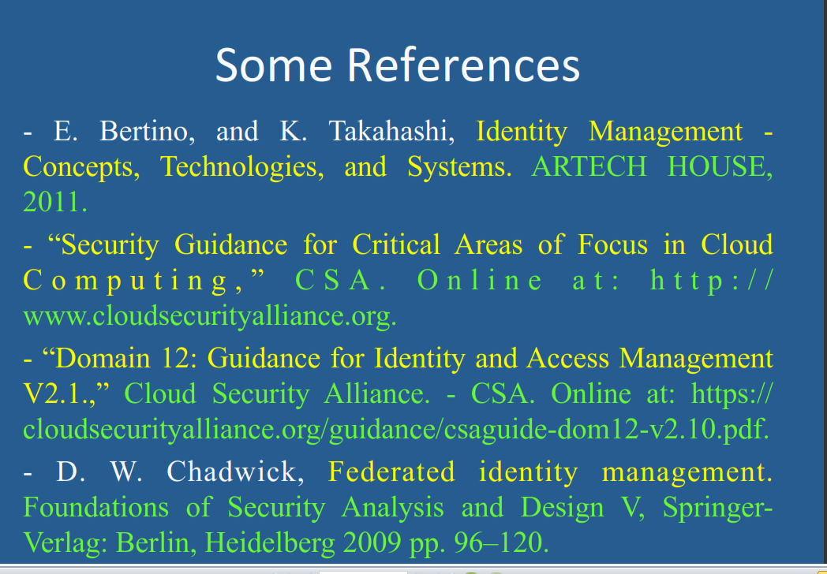

Slide 43
References for Identity
N. Delessy, E.B.Fernandez, and M.M. Larrondo-Petrie, "A pattern language for identity management", Procs. of the 2nd IEEE Int. Multiconference on Computing in the Global Information Technology (ICCGI 2007), March 4-9, Guadeloupe, French Caribbean.
http://www.computer.org/portal/web/csdl/doi/10.1109/ICCGI.2007.5
E.B.Fernandez, “Security patterns in practice: Building secure architectures using software patterns”, Wiley Series on Software Design Patterns, 2013. Chapter4: Identity Management
J. Rodriguez and J. Klug, “Federated identity patterns in a service-oriented world”, Microsoft Architecture Journal, 16, 6-11.
SOA Patterns, “Federated identity”, http://soapatterns.org/federated_identity.php

